Slide 1
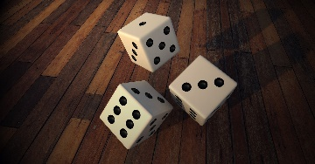
Culture Educational
Speaking
Being able to express your opinion
Listening
Active Listening with understanding
Creativity
Adding new thoughts to the discussion
Questions
Team Building
Asking poignant questions
.
The strength of weak ties
Filter
Socially narrow
What is predictable
To get randomness it requires some planning
Luck
Reach out to people
Create a word bank for discussion
How do you filter someone
See what you don’t want to see
Eliminate the transaction
When you are in trouble what do you do?
diversity
You have a ticket to travel your social universe
unpredictable
…
Christopher Bauman – www.chrisbauman.com.au

Slide 2
1. Are you a creature of habit ____________________________________________________________________________________________?
Advanced Question Words
2. Describe someone who is like you / describe someone who is different to you ___________________________________________________________________________________________ ?
paradox
Pay a price
3. How do you find and filter your friends ___________________________________________________________________________________________ ?
Socially narrow
4 What is interesting to you ___________________________________________________________________________________________ ?
randomness
How do you make yourself comfortable
Weak ties
5. Tell me how you met someone by accident ___________________________________________________________________________________________ ?
Stay close to home
6. What is your value? When did you last look at the weak ties on FB ___________________________________________________________________________________________ ?
Accidental bumps
7. How do you reach out to people ___________________________________________________________________________________________ ?
Social search engine
Bounce back
8. How can you bump into more people __________________________________________________________________________________ ?
Make your network inefficient
collaborate
What are you doing to break you away from your social hubs?
Describe an accident you have had?
Christopher Bauman – www.chrisbauman.com.au

Slide 3
